Slide 1

DIABETES PREDICATION Analysis
By Bittu kumar

Slide 2
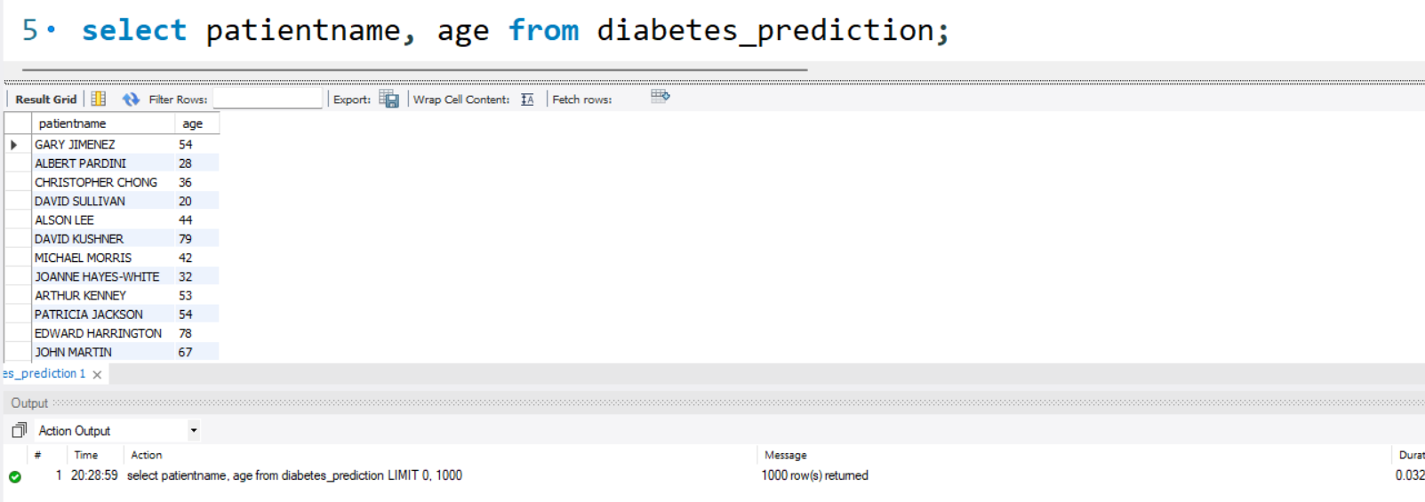
Retrieve the Patient_id and ages of all patients.

Slide 3
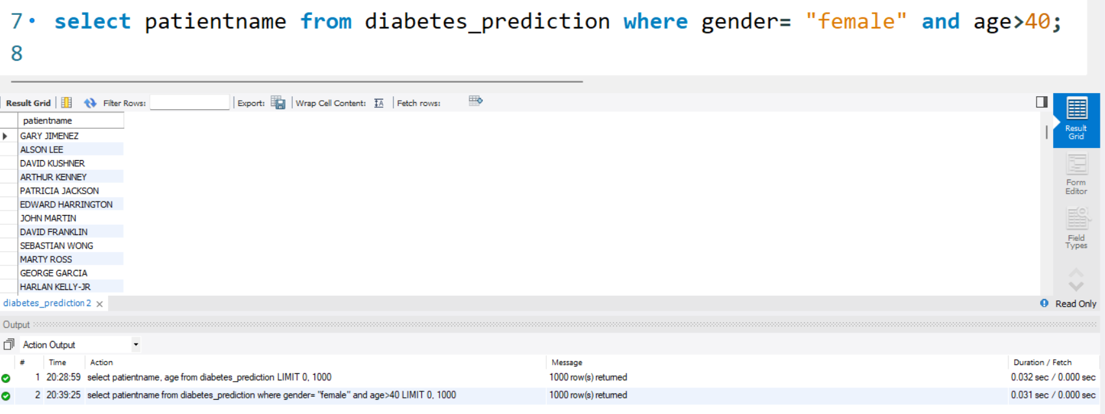
Select all female patients who are older than 40.

Slide 4
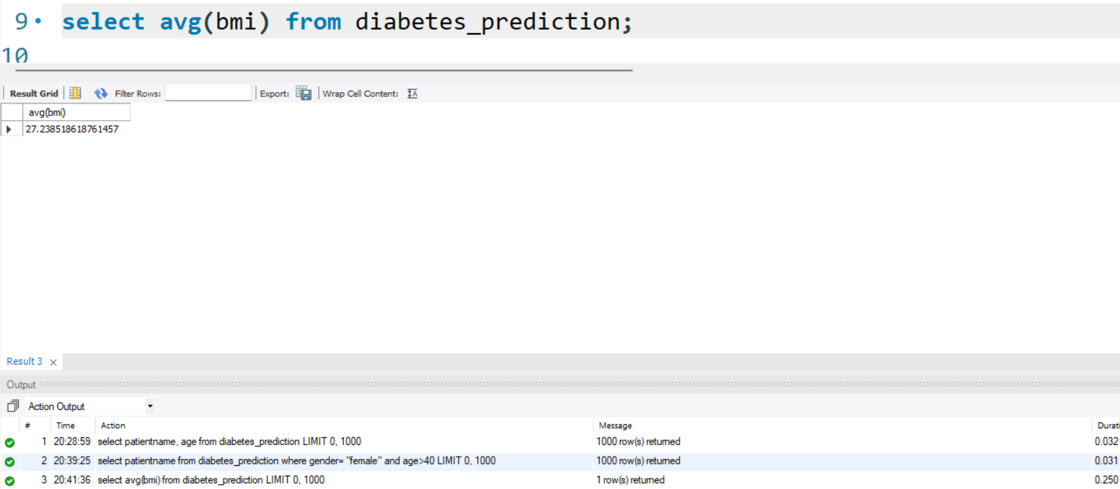
Calculate the average BMI of patients.

Slide 5
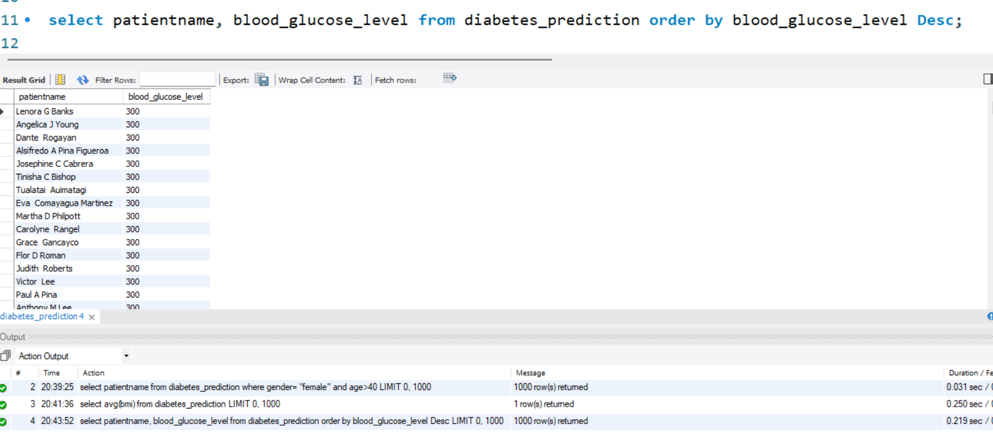
List patients in descending order of blood glucose levels.

Slide 6
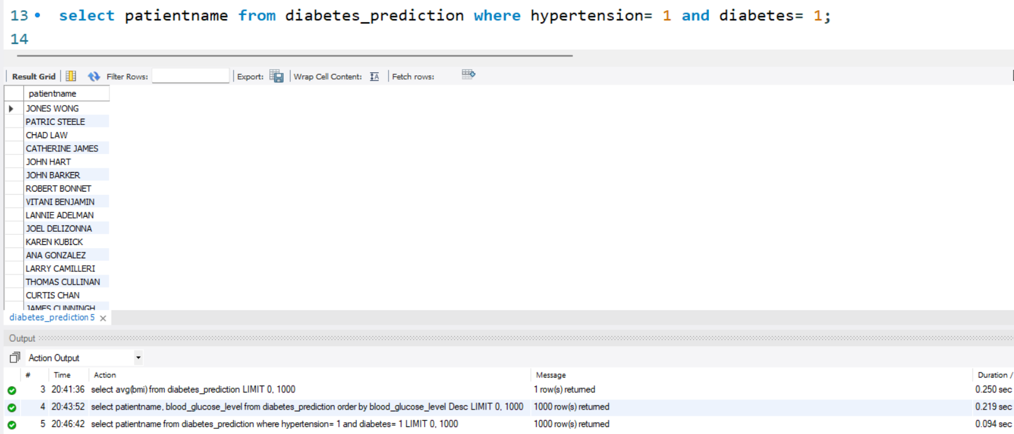
Find patients who have hypertension and diabetes.

Slide 7
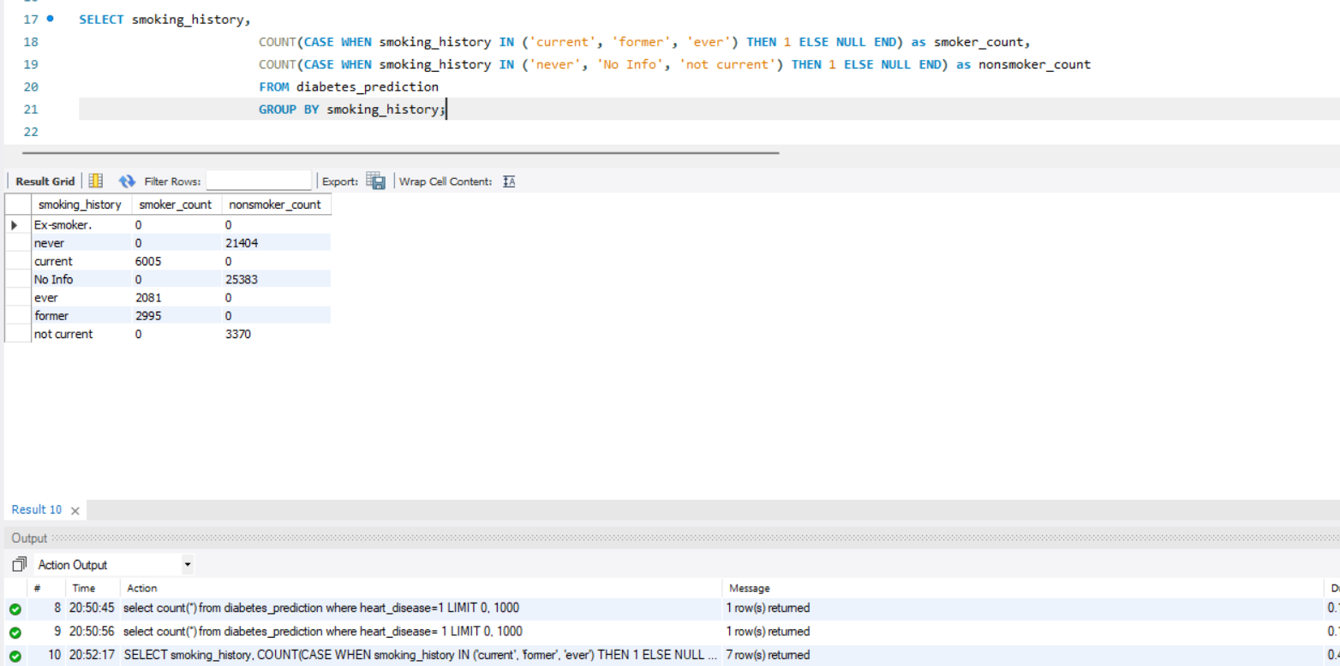
Group patients by smoking history and count how many smokers and nonsmokers there are.

Slide 8
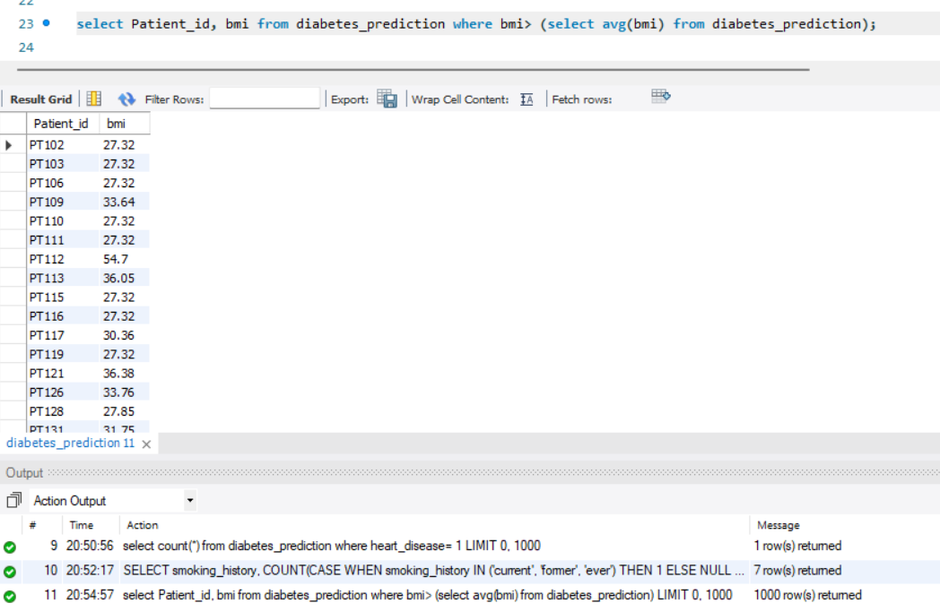
Retrieve the Patient_ids of patients who have a BMI greater than the average BMI.

Slide 9
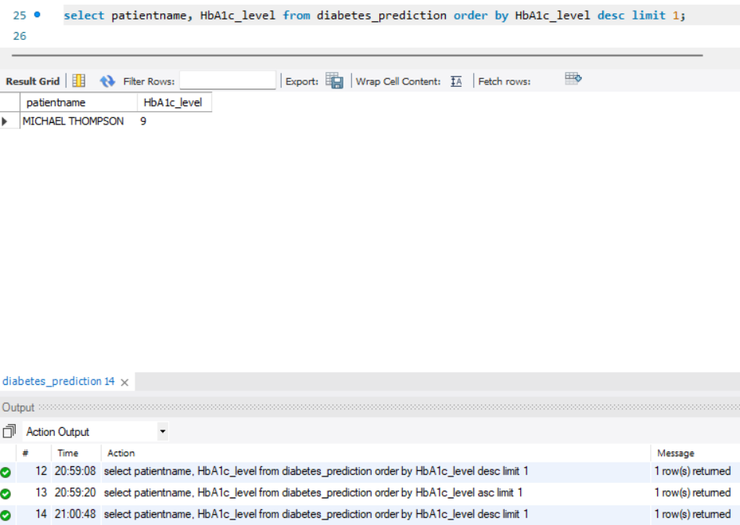
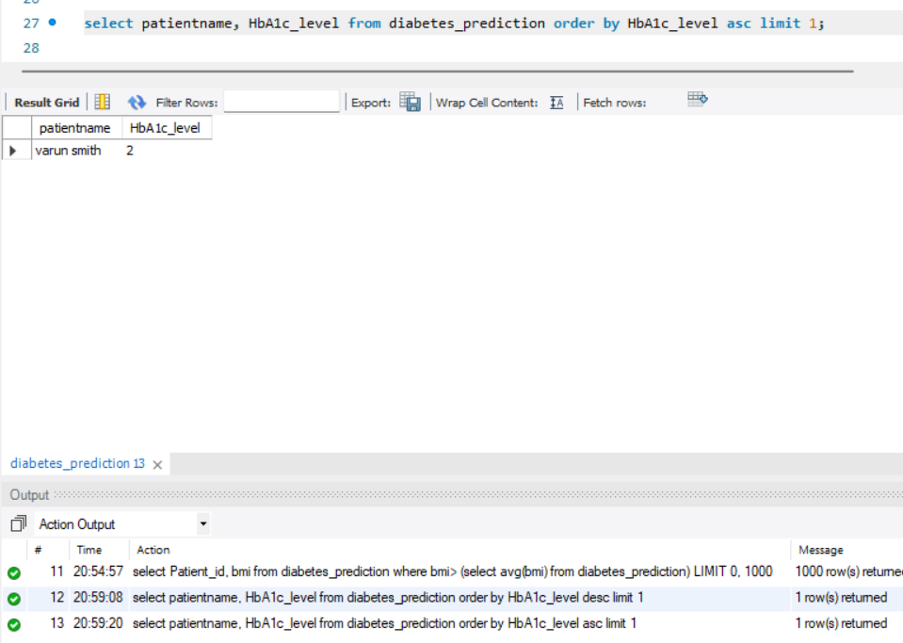
Find the patient with the highest HbA1c level and the patient with the lowest HbA1clevel.

Slide 10
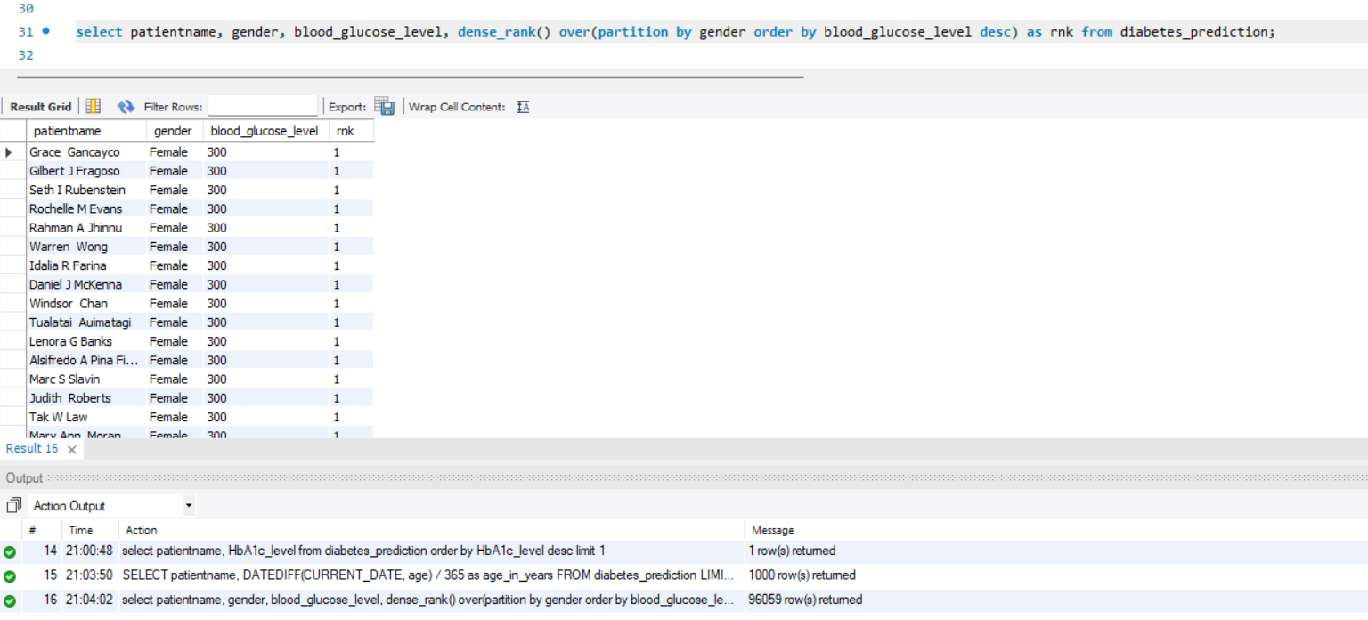
Rank patients by blood glucose level within each gender group

Slide 11
Update the smoking history of patients who are older than 50 to "Ex-smoker."

Slide 12
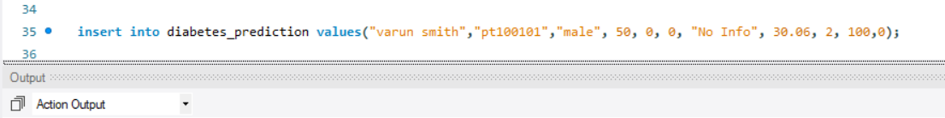
Insert a new patient into the database with sample data.

Slide 13
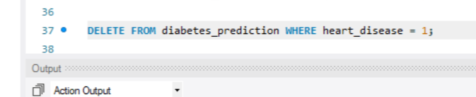
Delete all patients with heart disease from the database

Slide 14
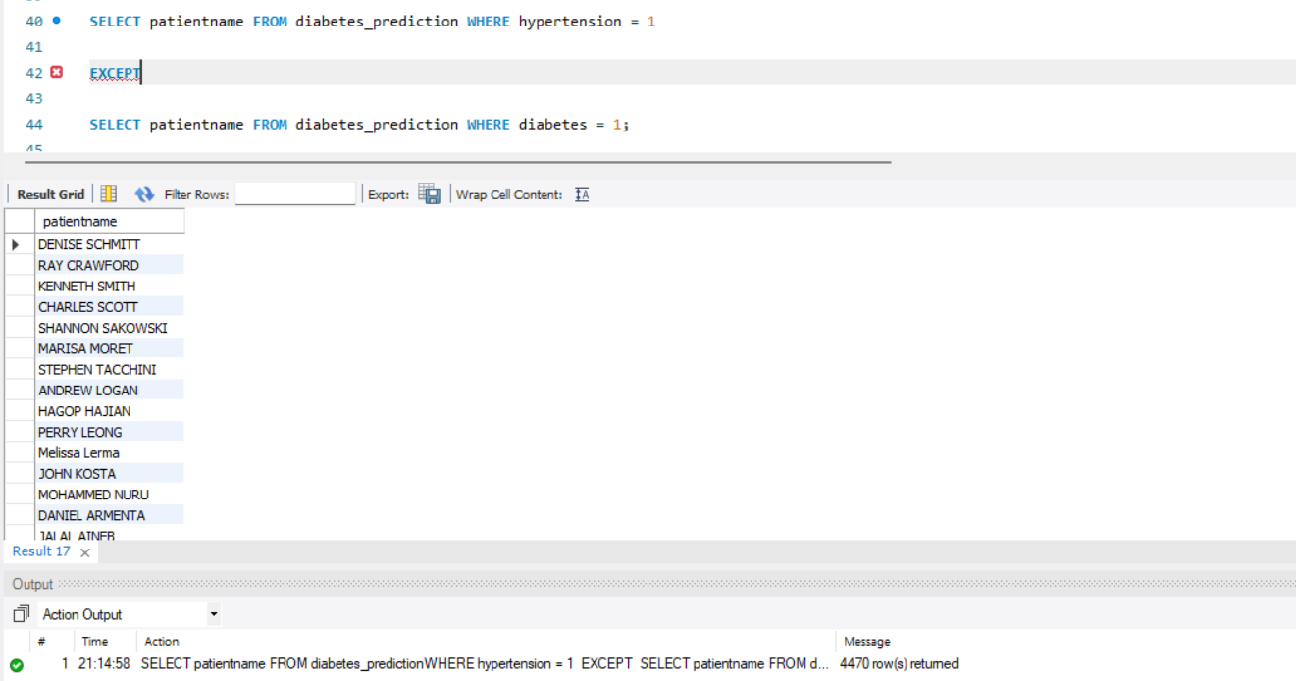
Find patients who have hypertension but not diabetes using the EXCEPT operator.

Slide 15
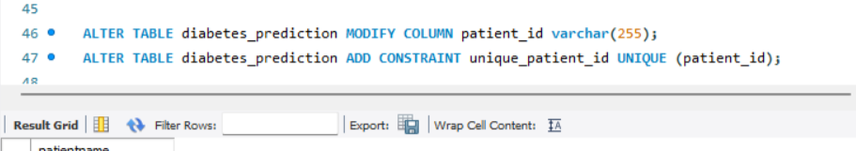
Define a unique constraint on the "patient_id" column to ensure its values are unique.

Slide 16
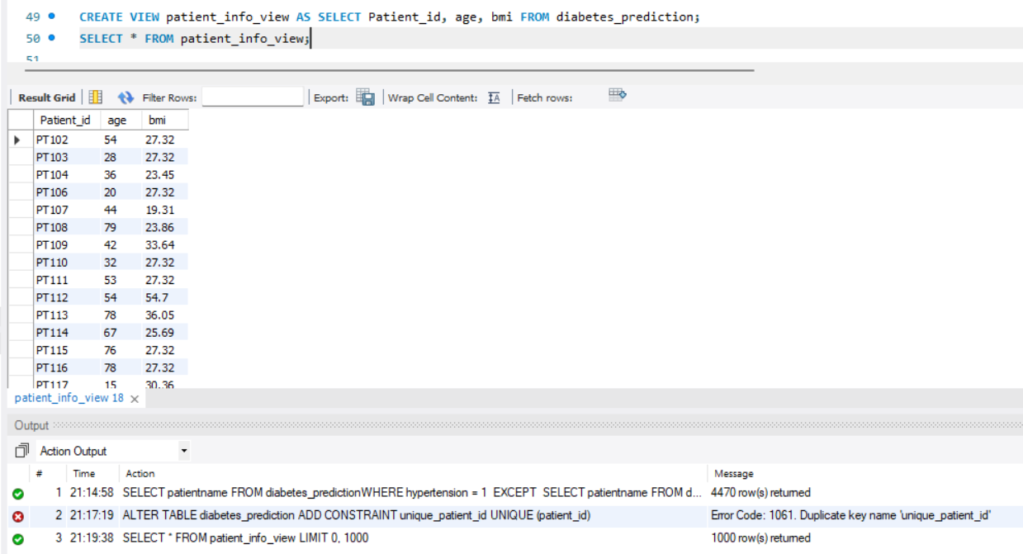
Create a view that displays the Patient_ids, ages, and BMI of patients

